Slide 1

PERSONAL INCOME AND EXPENSE MANAGEMENT
MENTORED BY:
ARAVINTH.P
PROJECT DONE BY:
ASMA TABASSUM
RAHUL DHANNARAPU
KALYAN BANAVATH
LOKESH REDDY P

Slide 2
INTRODUCTION
In this day and age, budgeting and saving money for investment is of the highest priority. In order to do that we need to keep track of the income and expenses.
The traditional way of tracking income and expenses is to maintain a diary and write down all the expenses or maintain them in csv files.
But with the fast-paced world we are living in , it’s very hard to always remember to make a note of all the expenses due to various reasons like stress and the busy life we live.
Traditional methods make it very difficult to categorize expenses as it involves a lot of manual labor and calculations for each category separately and there is always a risk of errors in calculations.

Slide 3
Traditional methods make it very difficult to search for a certain expense or to find a trend in expenses and also leads to a lot of unpopulated data which is overwhelming and hard to manage.
An expense management is used to maintain a log of all income and expenses and is very useful to know where you spent more money on and change our financial habits and be more aware of our expenditure and make savings.
The aim of the project is to create a smart income and expense management application which provides an authentication feature where you can log in or create a profile using email id and add income and expenses. You can insert and retrieve income and expenses in a simple manner. This application also provides the feature of adding income and expenses under categories .

Slide 4
TECHNOLOGY STACK:
● C#,ASP.NET MVC, Entity Framework Core, SQL SERVER,HTML,CSS,
Bootstrap, JavaScript, JQuery, GIT
● Operating System: Windows
● Integrated Development Environment (IDE) : Visual Studio 2022
● Web Browser: Microsoft Edge, Google Chrome, Mozilla Firefox

Slide 5
OBJECTIVES
User Login and Validation
Entering Income and Expenses into the Form
Saving the Form data into the database
Retrieving data from the database
We have a search button to search for a particular income and expense

Slide 6
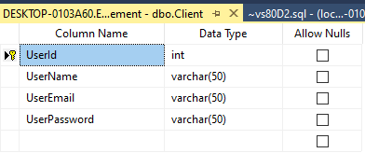
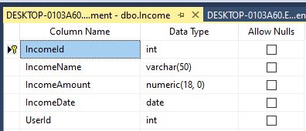
DATABASE DESIGN
USERS DATABASE :
INCOME DATABASE :

Slide 7
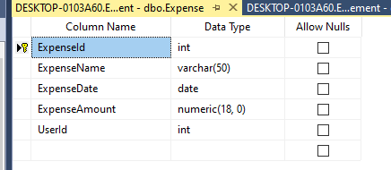
EXPENSE DATABASE:

Slide 8
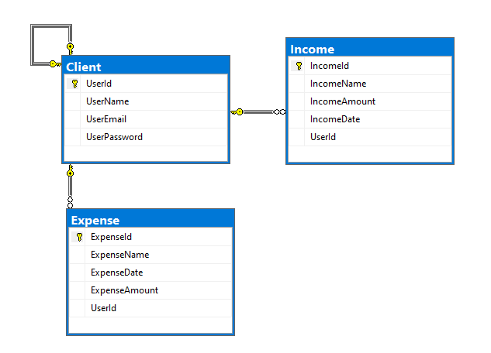
DATABASE DIAGRAM

Slide 9
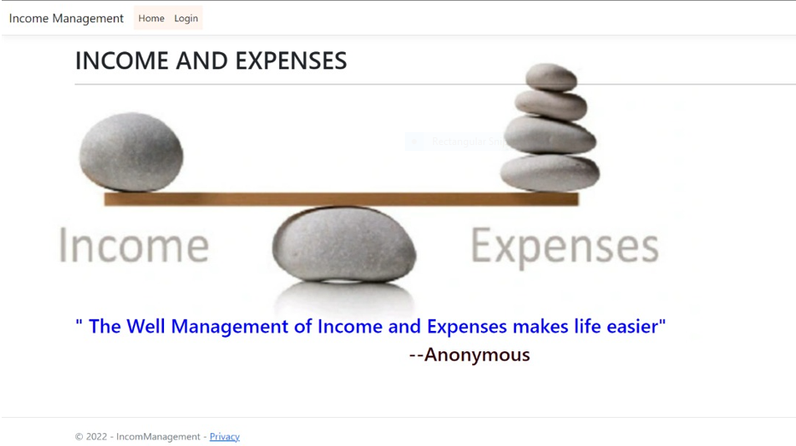
SNAPSHOT OF APPLICATION
HOME PAGE

Slide 10
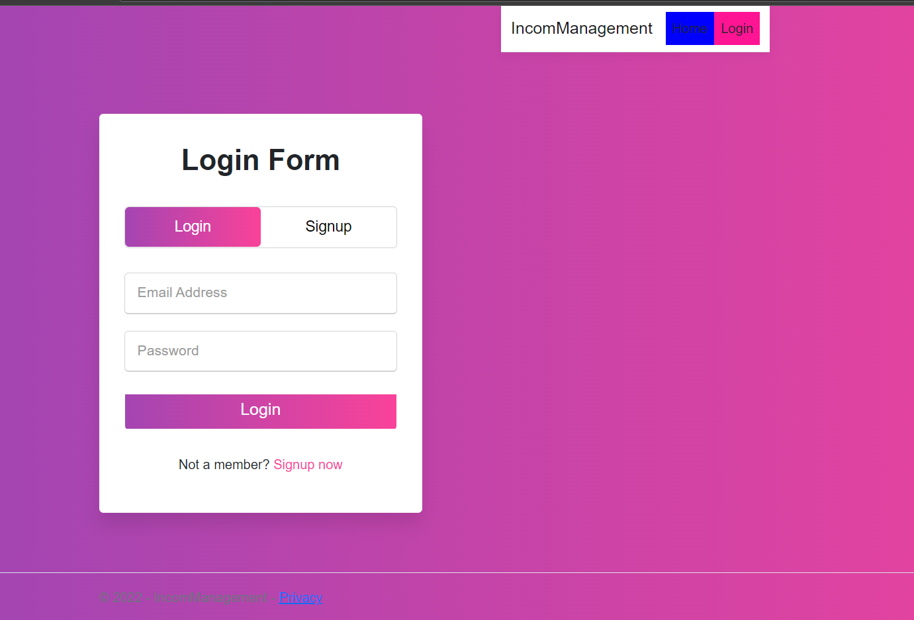
HTML PAGES
i. LOGIN PAGE

Slide 11
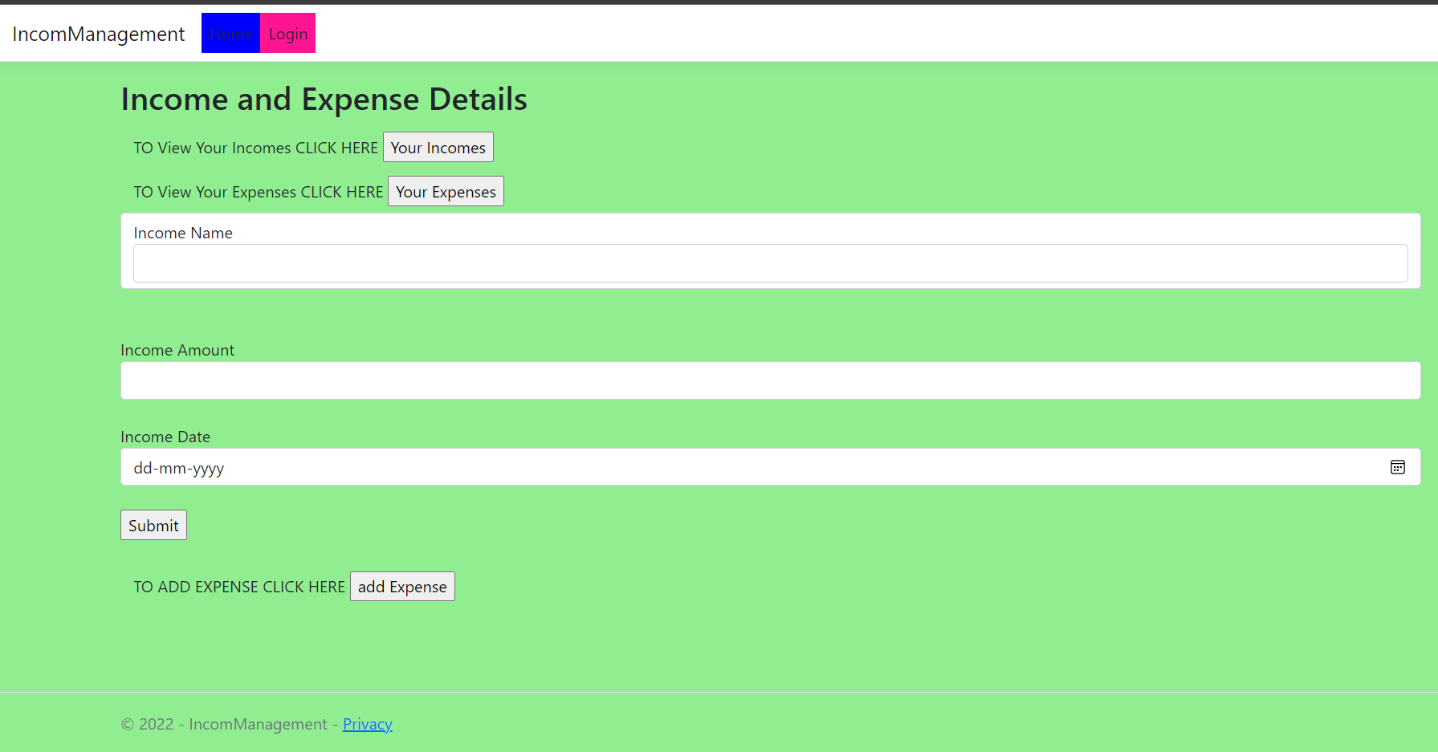
ii. INCOME PAGE

Slide 12
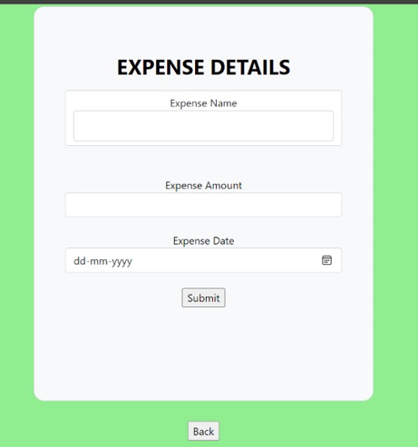
iii. EXPENSE PAGE

Slide 13
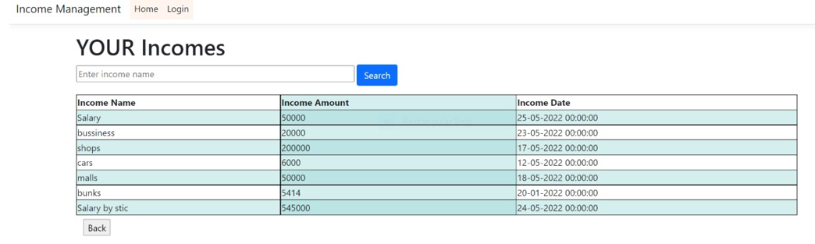
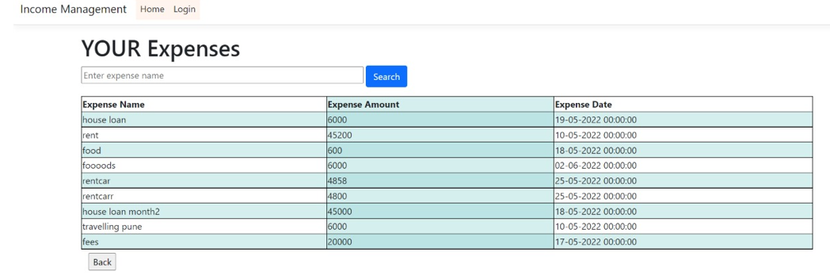
VIEW OF INCOME AND EXPENSES

Slide 14
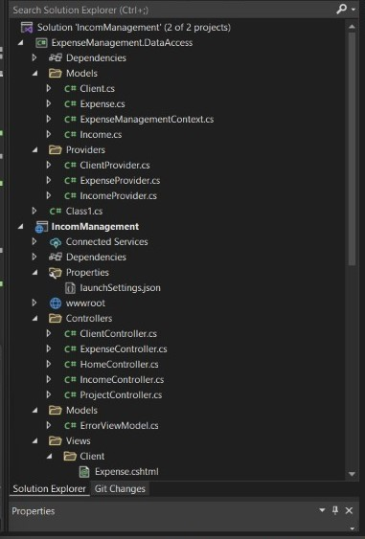
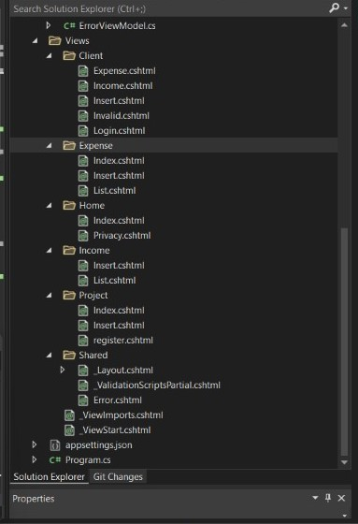
SOLUTION EXPLORER

Slide 15
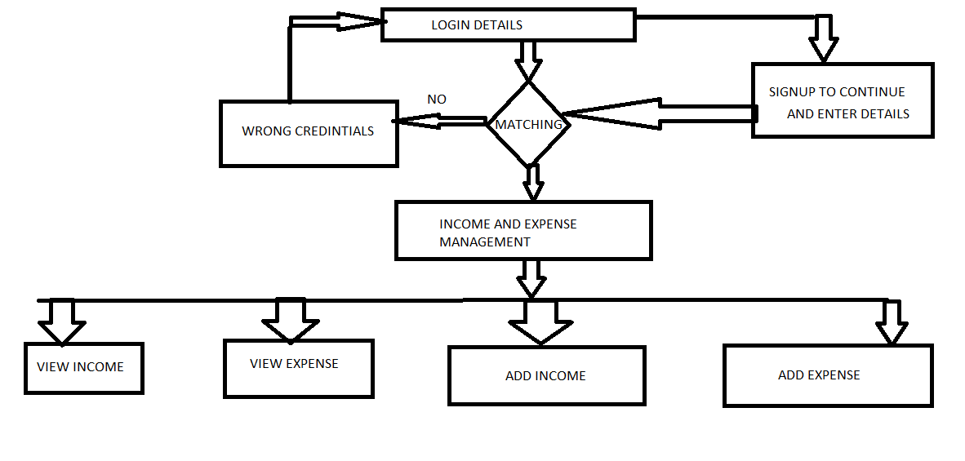
FLOW OF THE APPLICATION

Slide 16
CONCLUSION
We assure that this will help users to manage the cost of their daily expense
Helpful for the people who are frustrated with the daily budget management
Wish to manage money
Preserve the record of their daily cost
Overcome wastage of money

Slide 17
ANY QUERIES?

